Slide 1
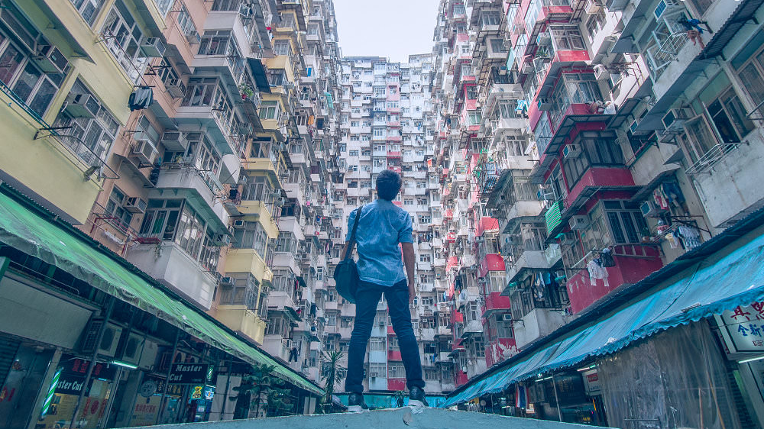
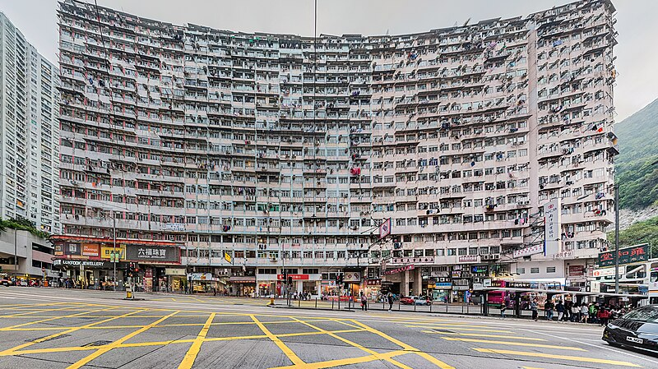
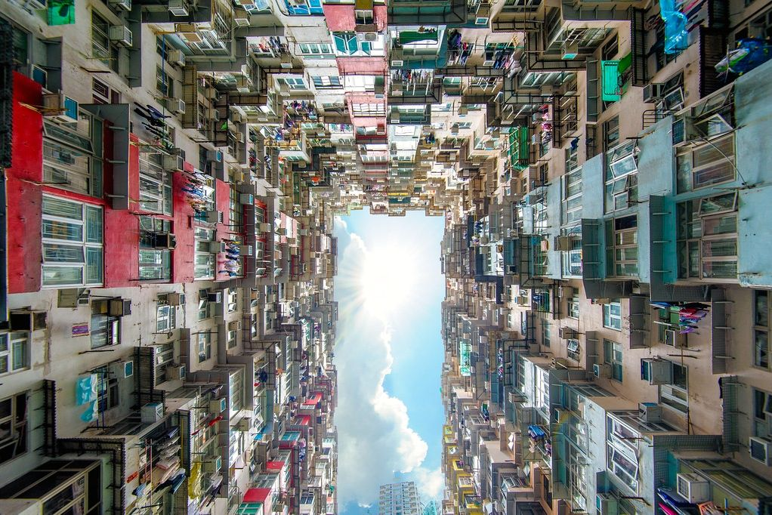
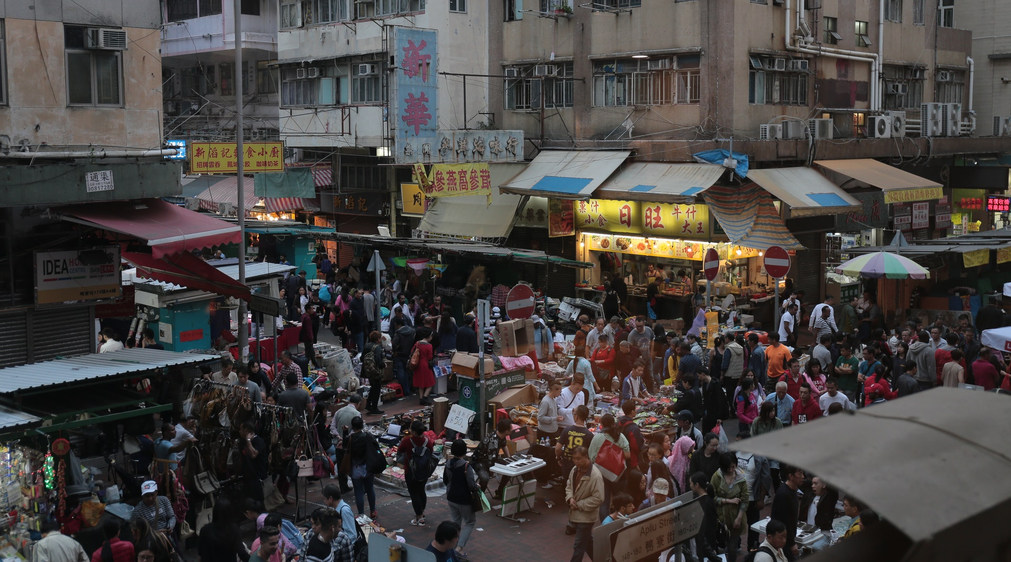
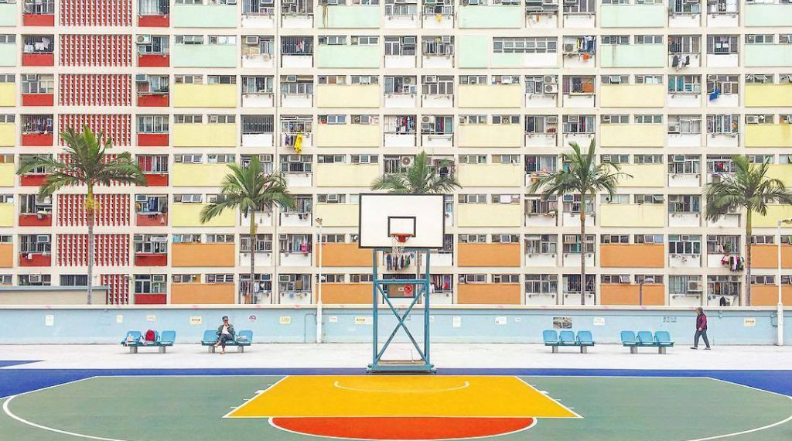

Slide 2
Description
This is the iconic tourist punch of point: Monster building
Keyboard: Poverty
This mood board tries to show the poverty in Hong Kong in terms of the living space of Hong Kong citizens.

