Slide 1
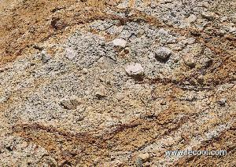
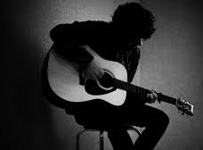
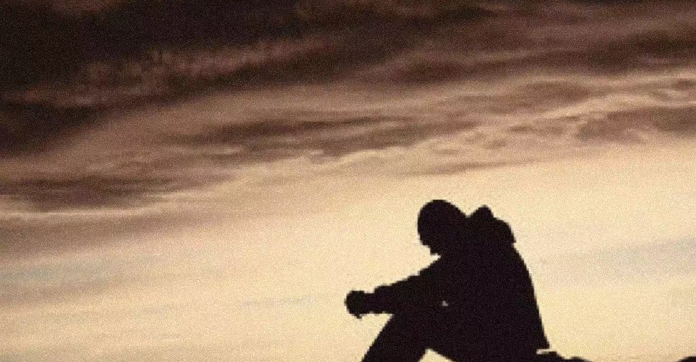
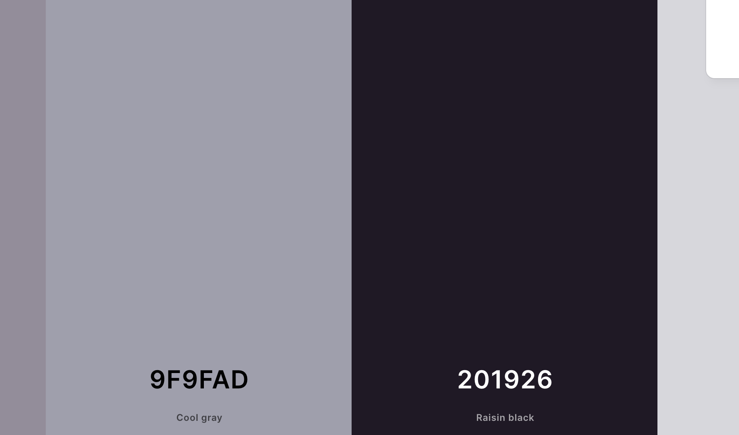
Sunset of city

Slide 2
Description
My topic for the video essay is the vanishing city. Thus, I pick lightning as the light of sunset. The sound is the wind sound. The texture is sandy. The colors are dark and grey. The items are the old buildings. These items show the sadness and mourning towards the vanishing old spaces in HK.

